Slide 1



Data Types, Casting and Keywords in Java
JAVA

Slide 2
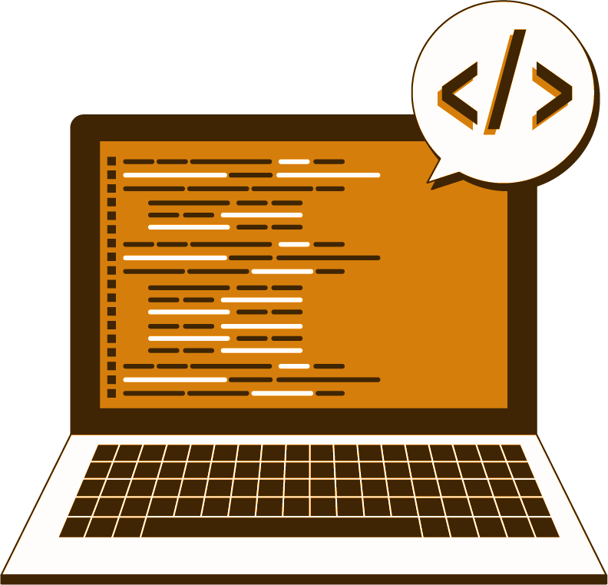
List of Concepts Involved:
Java Identifiers
Java Data Types
Java Reserved words
TypeCasting in primitive types

Slide 3
Java Identifiers
An identifier is a name given to a package, class, interface, method, or variable. All identifiers must have different names.
In Java, there are a few points to remember while dealing with identifiers :
Rule 1 − All identifiers should begin with a letter (A to Z or a to z), $ and _ and must be unique.
Rule 2 − After the first character/letter, identifiers can have any combination of characters.
Rule 3 − A keyword cannot be used as an identifier.
Rule 4 − The identifiers are case-sensitive.
Rule 5 – White Spaces are not permitted.
Examples of legal identifiers: rank, $name, _rate, __2_mark.
Examples of illegal identifiers: 102pqr, -name.

Slide 4
Data Types:
There are two types of data types in Java:
Primitive data types: The primitive data types include boolean, char, byte, short, int, long, float and double.
Non-primitive data types: The non-primitive data types include classes, Strings, Interfaces, and Arrays.

Slide 5
Contd..
Java Data Types
Primitive
Non-Primitive
Integer
Float-Point Number
Characters
Boolean
String
Array
Short
double
char
boolean
Classes
byte
float
Etc
int
long

Slide 6
Java Reserved words
Reserved words are words that cannot be used as object or variable names in a Java program because they're already used by the syntax of the Java programming language.
boolean | byte | char | double | float
short | void | int | long | while
for | do | switch | break | continue
case | default | if | else | try
catch | finally | class | abstract | extends
final | import | new | instance of | private
interface | native | public | package | implements
protected | return | static | super | synchronized
this | throw | throws | transient | volatile

Slide 7
TypeCasting in primitive types
Changing a value from one data type to another data type is called as data type conversion.
Assigning a value of one type of a variable of another type is known as type casting.
Types of type Casting:
Implicit Type Casting
Explicit Type Casting

Slide 8
Contd..
Automatic Type Conversion
byte
short
int
long
float
double
char

Slide 9

THANK YOU

